Slide 1
DNA Variant Calling by Current-Generation Sequencing
John Didion, PhD

Slide 2
APPLICATIONS OF VARIANT CALLING
Clinical
Screening
Diagnosis
Precision medicine (e.g. pharmacogenetics)
Research
Gene/trait mapping (GWAS)
Cancer (somatic mutations)
Molecular epidemiology
Population/evolutionary genetics

Slide 3
APPLICATIONS OF VARIANT CALLING
Clinical
Screening
Diagnosis
Precision medicine (e.g. pharmacogenetics)
Research
Gene/trait mapping (GWAS)
Cancer (somatic mutations)
Molecular epidemiology
Population/evolutionary genetics

Slide 4
NGS Basics
Experimental design
Library preparation and sequencing
Data quality
Alignment
Variant calling

Slide 5
NGS Basics
Experimental design
Library preparation and sequencing
Data quality
Alignment
Variant calling

Slide 6
EXPERIMENTAL DESIGN
Key Considerations
Genome status: existing reference or de novo?
Whole genome or targeted (e.g. exome or specific genes/region)?
Target size: large (e.g. human, mouse genome) or small (e.g. bacteria, virus)?
Sample size
Mutation types and frequencies
Acceptable discovery rate (i.e. sensitivity)

Slide 7
EXPERIMENTAL DESIGN
Questions to Answer
How many replicates?
What sequencing technology to use?
How to prepare the sequencing libraries?
How deeply to sequence?
What is my budget?

Slide 8
EXPERIMENTAL DESIGN
Costs and Caveats
Typically, total sequencing depth (N * D) must equal a fixed increment
The “usable” data you will get is only a fraction of D (the theoretical maximum)
On a per-library basis, L, S, and B are often significantly lower for large versus small experiments
Recommendation: make friends with your sequencing core director!
N = Number of Samples
L = Library preparation cost
S = Cost per unit of sequencing
D = Depth of sequencing per sample
B = Bioinformatics
Depth (D) = data size (bp) / genome size
Cost = N * [ L + (S * D) + B ]

Slide 9
EXPERIMENTAL DESIGN
Key Considerations
Organism genome status: existing reference or de novo?
Whole genome or targeted (e.g. exome or specific genes/region)?
Target size: large (e.g. human, mouse genome) or small (e.g. bacteria, virus)?
Sample size
Mutation types and frequencies
Acceptable discovery rate (i.e. sensitivity)

Slide 10
EXPERIMENTAL DESIGN
Alignment versus Assembly
Alignment: Identifying the mostly likely reference genome coordinate of origin for the sequences generated from your sample
Assembly: Create a genome de novo by stitching together the sequences generated from your sample

Slide 11
EXPERIMENTAL DESIGN
Alignment versus Assembly
Alignment
Requires less sequencing (both depth and read sizes)
Easier and faster bioinformatic analysis
Requires a “finished” reference genome
May miss larger structural variants
Assembly
Often the best (and sometimes only) option for non-model organisms
Requires (costly) deep sequencing with long reads
Assembly is complicated and time-consuming; often several rounds of sequencing are required to “finish” the genome
Hybrid strategies can provide benefits of both approaches

Slide 12
EXPERIMENTAL DESIGN
Key Considerations
Organism genome status: existing reference or de novo?
Whole genome or targeted (e.g. exome or specific genes/region)?
Target size: large (e.g. human, mouse genome) or small (e.g. bacteria, virus)?
Sample size
Mutation types and frequencies
Acceptable discovery rate (i.e. sensitivity)

Slide 13
EXPERIMENTAL DESIGN
Whole-genome versus Targeted
Whole genome sequencing minimizes bias at the expense of greater overall sequencing cost
Targeted sequencing (exome, amplicon) is typically less expensive overall, but don’t forget the cost of sequence capture
In terms of cost-per-base, WES is ~5x more expensive than WGS

Slide 14
EXPERIMENTAL DESIGN
Whole-genome versus Targeted
Targeted sequencing introduces several sources of bias:
Capture efficiency
PCR amplification (CG bias, size bias, errors)*
Reference bias (unless you use a carefully designed custom capture library)
Coverage non-uniformity
* Can also affect WGS, depending on library preparation method

Slide 15
EXPERIMENTAL DESIGN
Whole-genome versus Targeted
General guidelines
For small genomes and/or genome assembly: deep whole-genome
For a small number of known regions: amplicon
For many genes, a known Mendelian trait, and/or potentially rare coding mutations: exome
Otherwise: whole-genome

Slide 16
EXPERIMENTAL DESIGN
Key Considerations
Organism genome status: existing reference or de novo?
Whole genome or targeted (e.g. exome or specific genes/region)?
Target size: large (e.g. human, mouse genome) or small (e.g. bacteria, virus)?
Sample size
Mutation types and frequencies
Acceptable discovery rate (i.e. sensitivity)

Slide 17
EXPERIMENTAL DESIGN
Sample Size versus Sequencing Depth
Most important and most difficult decision
How rare are your variants of interest within the population being studied?
How difficult is it to confidently detect variants?
For population studies (e.g. GWAS), larger sample is usually better than greater depth
Power analysis is key: is your sample large enough to make the study worthwhile?
Remember: you can always re-sequence, or follow up with targeted validation

Slide 18
EXPERIMENTAL DESIGN
Sample Size versus Sequencing Depth
For variant calling in individual humans, the general recommendation is:
20-60x WGS
80-120x WES
For population studies of common variants, coverage as low as 0.5x can yield recall rates of 0.8 or more (“genotyping by sequencing”)

Slide 19
NGS Basics
Experimental design
Library preparation and sequencing
Data preprocessing
Alignment
Variant calling

Slide 20
SEQUENCING TECHNOLOGY
Third Generation
Direct sequencing
Long reads
Missing:
Illumina NovaSeq
Oxford Nanopore GridION and PromethION
PacBio Sequel
Second Generation
“Massively Parallel SBS”
First Generation
“Sequencing by Synthesis”

Slide 21
SEQUENCING TECHNOLOGY
So which should I use?
At least for today, the answer is almost always Illumina

Slide 22
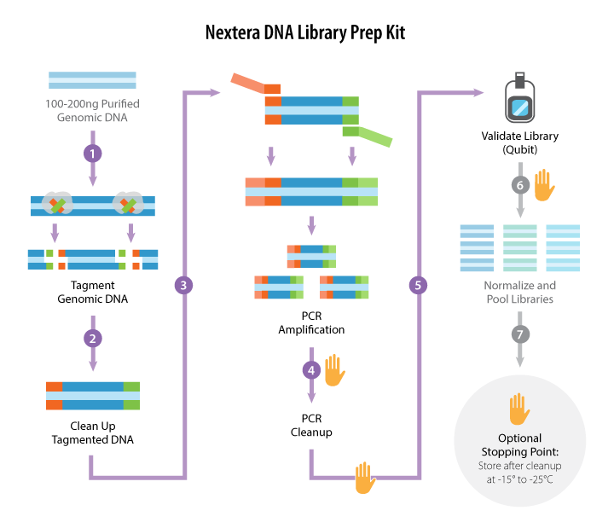
ILLUMINA DNA LIBRARY PREPARATION
Option 1: Nextera (e.g. “Tagmentation”)
https://www.abmgood.com/

Slide 23
ILLUMINA DNA LIBRARY PREPARATION
Option 1: Nextera (e.g. “Tagmentation”)
Fast: 1.5 hr total time, 15 min hands-on
Inexpensive
Low DNA input requirement (50 ng)
High-throughput: indexed adapters available in 96 well format
Potential for bias:
PCR
Transposase insertion

Slide 24
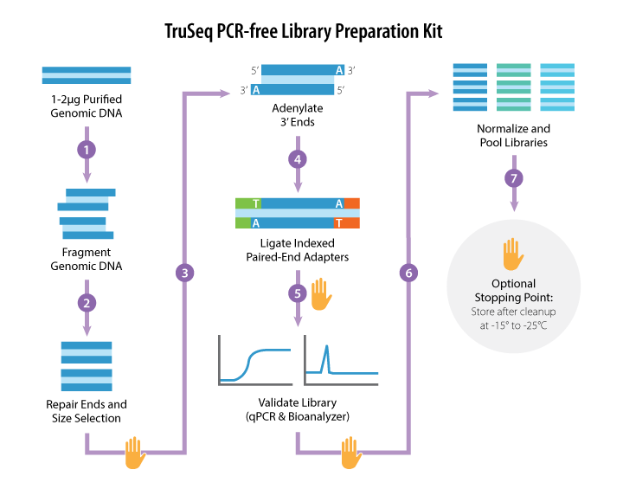
ILLUMINA DNA LIBRARY PREPARATION
Option 2: TruSeq PCR-free
https://www.abmgood.com/

Slide 25
ILLUMINA DNA LIBRARY PREPARATION
Option 2: TruSeq PCR-free
Less potential for bias
Fewer duplicate reads, can reduce sequencing requirements by ~40%
Larger input DNA requirement (1-2 ug)
More expensive (~3x), complex, time-consuming
qPCR or MiSeq run required to validate libraries

Slide 26
ILLUMINA DNA LIBRARY PREPARATION
Multiplexing
Each library is tagged with an index
Often, paired-end libraries are tagged with two indexes – one on each end
Libraries are pooled prior to sequencing
Increases the number of libraries you can sequence in parallel
Multiplexing is one of the most important things you can do to increase data quality

Slide 27
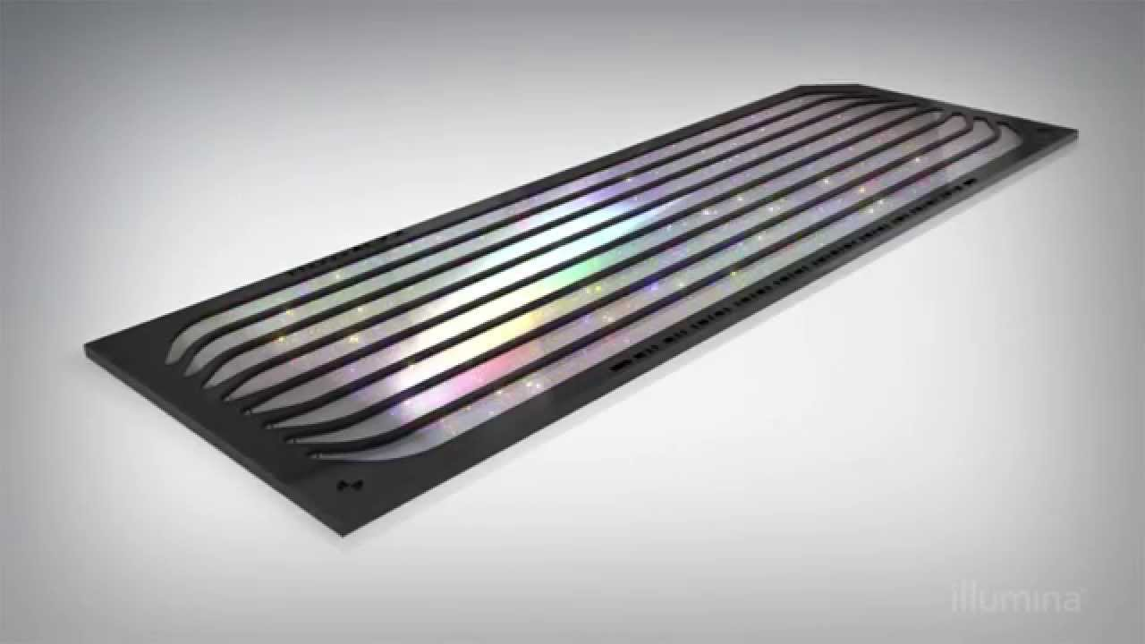
ILLUMINA DNA SEQUENCING
Illumina Flow Cell

Slide 28
ILLUMINA DNA SEQUENCING
Single end (SE) versus paired end (PE)
PE is currently most common, and almost always the best choice
Read pair information significantly improves alignment accuracy
Short fragment sizes can be used to generate redundant sequences – useful when variant frequency near/below level of sequencing error
Exceptions include miRNA-seq (very short fragments)

Slide 29
ILLUMINA DNA SEQUENCING
Read length (50-250 bp)
Key considerations:
Size and frequency of repeats in the genome?
What is expected divergence from the reference?
For variant calling in humans, PE 125 or 150 bp on HiSeq 2500/3000/4000/X is standard
For small highly variable organisms (e.g. E. coli), PE 250 bp on MiSeq
C. Elegans has much lower rate of intergenic/repetitive DNA: shorter reads and even SE acceptable

Slide 30
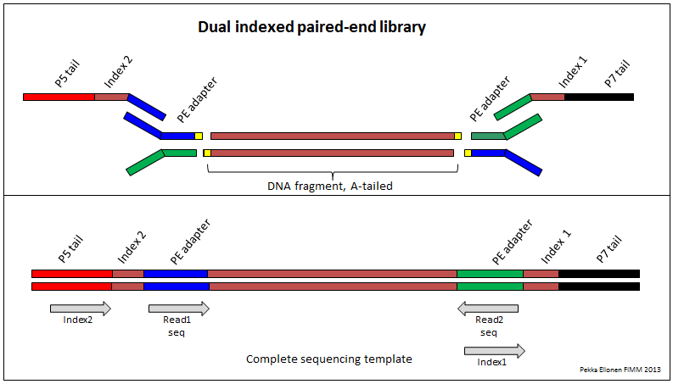
SEQUENCING DATA ANALYSIS
Anatomy of an Illumina Sequencing Read
5’
5’
5’
5’

Slide 31
SEQUENCING DATA ANALYSIS
What do I get from the Genomics Core?
Bases are called using Illumina software
For each read, the software reports:
A sequence of R bases (A/C/G/T/N), where R is the read length
A sequence of R quality scores, where each score is the probability that the corresponding base call is incorrect
Often, libraries will be de-multiplexed into one file (or set of files) per library
Data will be in one of two formats: FASTQ or SAM/BAM

Slide 32
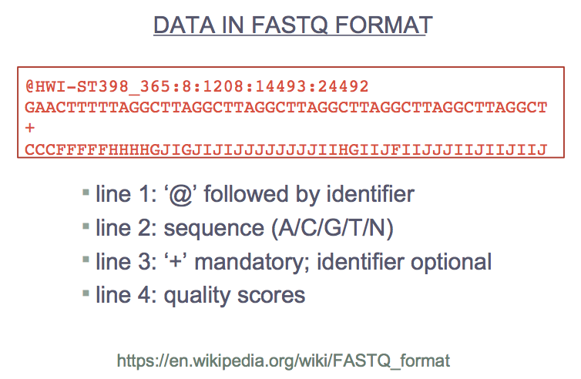
SEQUENCING DATA ANALYSIS

Slide 33
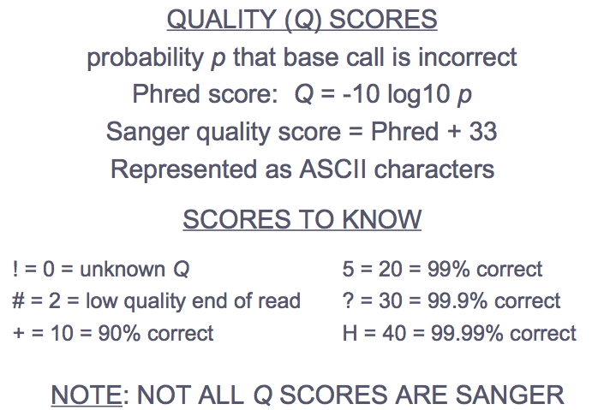
SEQUENCING DATA ANALYSIS

Slide 34
NGS Basics
Experimental design
Library preparation and sequencing
Data quality
Alignment
Variant calling

Slide 35
DATA QUALITY
Common Issues
Non-random nucleotide composition, especially in the first ~13 bp at 5’ end
Degraded quality at 3’ ends of reads
Adapter contamination (“read-through”)
Adapter dimers
PCR duplicates
Diagnostic tool: FastQC

Slide 36
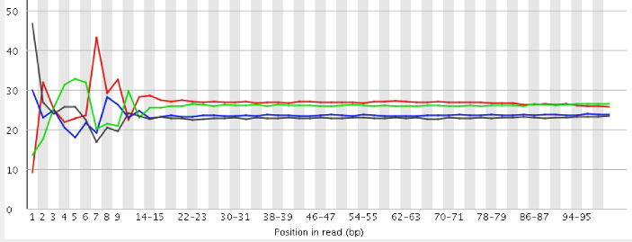
DATA QUALITY
Non-random Nucleotide Composition
Mostly affects RNA-seq and Nextera libraries
Cause is somewhat mysterious – probably due to polymerase/transposase biases
Cannot be corrected, but doesn’t seem to affect downstream analysis

Slide 37
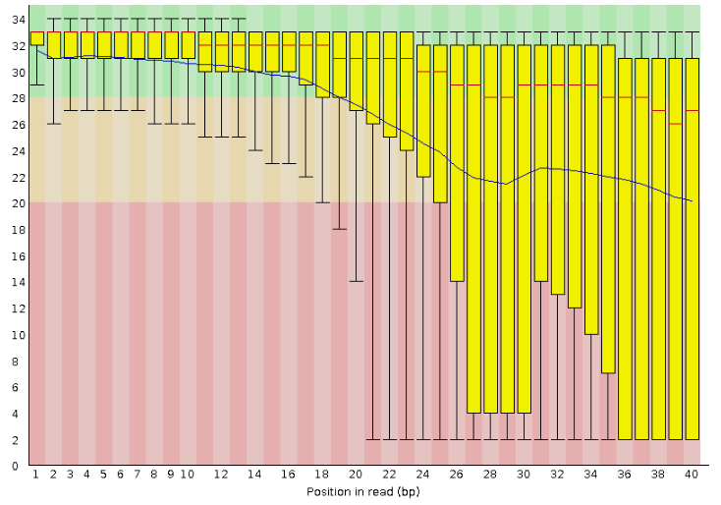
DATA QUALITY
Degraded Quality

Slide 38
DATA QUALITY
Degraded Quality
Mean quality drops below some threshold (30)
Commonly happens at 3’ end of read – especially longer read lengths; this is because the fidelity of the sequencing chemistry degrades with distance
Can be corrected by quality trimming; whether necessary depends on your experiment
Can also arise from sequencer issues
In extreme cases, it may be necessary to re-sequence the library; the sequencing core should catch these

Slide 39
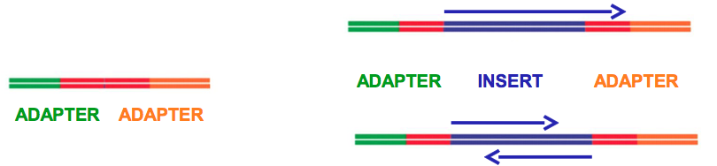
DATA QUALITY
Adapter Contamination
When insert size is shorter than read length, the sequencer reads past end of the insert into the opposite-end adapter
Largely corrected by adapter trimming (Step 4)
Adapter dimers occur when adapter pairs ligate to each other rather than inserts
Not possible with libraries prepared by tagmentation
Easily eliminated by adapter trimming (Step 4)
Large-scale issues usually detected during library QC
Adapter read-through
Adapter dimer

Slide 40
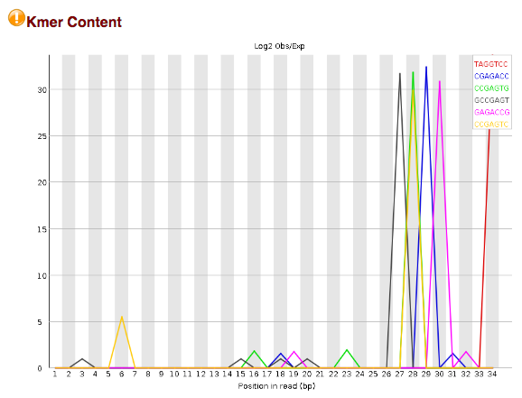
DATA QUALITY
Adapter Contamination

Slide 41
DATA QUALITY
Adapter and Quality Trimming
Tools: Atropos, Skewer, many others
Remove adapter sequences
Remove low-quality bases
Most trimmers can also filter out undesired reads, e.g. too short
For paired-end reads, if one end is considered undesirable, then both are filtered out

Slide 42
DATA QUALITY
PCR (or “Optical”) Duplicates
Sequencing multiple copies of the same DNA fragment
Detected as multiple reads with identical sequence
Can cause variant calling errors
We will mark duplicates in our alignment pipeline, and the variant caller will ignore them
Reads from highly repetitive regions will also show up as duplicates; eliminating these is fine, as repetitive regions are typically excluded from variant calling

Slide 43
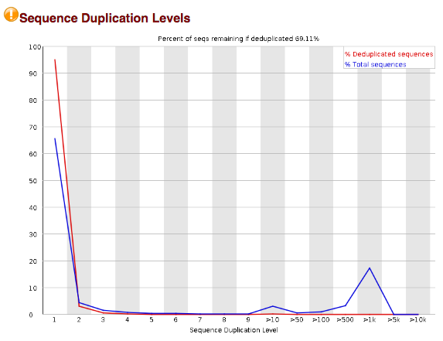
DATA QUALITY
PCR (or “Optical”) Duplicates

Slide 44
DATA QUALITY
Less Common Issues
Sample swaps
Identified by independent genotyping (e.g. sequencing replicate, microarray)
Cross-contamination
Same species: will show up as many “impossible” allele frequencies (0.25, 0.75)
Different species: large fraction of unmappable reads, significantly different GC content
“Weird” quality profiles
Dip in quality in beginning or middle of read
Tile failures
Due to transient sequencer issues, flow cell “bubbles”

Slide 45
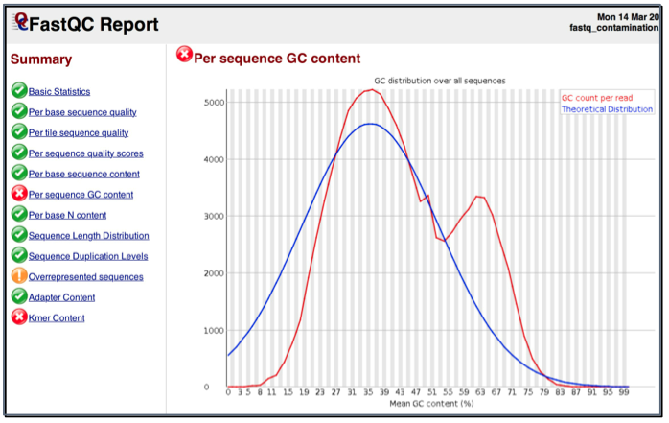
DATA QUALITY
Microbial Contamination

Slide 46
VARIANT CALLING WORKFLOW
Experimental design
Library preparation and sequencing
Data quality
Alignment
Variant calling

Slide 47
ALIGNMENT
Functions of an Alignment Tool
Identify the most likely reference genome coordinate(s) (chromosome, position, and strand) from which each fragment originated
Determine the sequence differences between each read and the reference genome
Calculate a probability that each alignment is correct (mapping quality score)

Slide 48
ALIGNMENT
reference sample
Mismatches
CGGAAGTTC
CGGAGGTTC
Complex Variants
CGGAAG-TTC
CGGAGCTTTC
Insertions
or
CGGAA-GTTC
CGGAACGTTC
CGGAAG--TTC
CGGA-GCTTTC
or
Deletions
CGGAAG-TTC
CGGA-GCTTTC
CGGAAGTTC
CGGAA-TTC

Slide 49
ALIGNMENT
Pipeline
Tools: BWA, Samblaster, Samtools
First build index of reference genome (or download prebuilt index)

Slide 50
INTERLUDE: REFERENCE GENOMES
One reference genome for each species
The current human genome reference is GRCh38
Many people are still using GRCh37 (hg19)
References evolve over time
Errors corrected
Gaps filled in
Alternative (or “alt”) sequences added: large haplotypes that differ substantially between individuals or populations
Next reference likely to be graph-based

Slide 51
INTERLUDE: REFERENCE GENOMES
For each reference version (or “build”) there is one canonical sequence, but different annotations
Big (annoying) difference: chromosome names
GRC/NCBI: NC000001, NC000002, …, NC000024
UCSC: chr1, chr2, …, chrX, chrY
Ensembl: 1, 2, …, X, Y
Recommendations
Use same genome/annotation set for entire project
All new projects should use GRCh38

Slide 52
ALIGNMENT
Alignment Results: SAM/BAM Formats
SAM: Sequence Alignment/Map Format
BAM: Binary (compressed) SAM
@HD VN:1.4 GO:none SO:coordinate
@SQ SN:1 LN:249250621
@SQ SN:2 LN:243199373
@SQ SN:3 LN:198022430
...
@RG ID:U0a_A2_L1 PL:illumina PU:1 LB:1 SM:NA12878
@RG ID:U0a_A2_L2 PL:illumina PU:1 LB:1 SM:NA12878
@RG ID:U0a_A_L1 PL:illumina PU:1 LB:1 SM:NA12878
...
@PG ID:GATK PrintReads VN:2.8 number=-1 simplify=false ...
@PG ID:GATK IndelRealigner VN:2.8 LODThresholdForCleaning=5.0 ...

Slide 53
ALIGNMENT
Exploring Alignment Results
READ.1 99 1 9976 38 130M1I14M3S = 10256 432 CTAACCCTAACCCT... ??;??=@A@?>??>... NM:i:37 AS:i:87 XS:i:87 RG:Z:U3b_A4_L1
READ.2 147 1 10256 28 74M1D13M5D33M2I26M = 9976 -432 AACCCGAACCCTAA... 101./,45@99+5;... NM:i:18 AS:i:70 XS:i:77 RG:Z:U3b_A4_L1
More about SAM/BAM format
Flags (col 2): each bit has a different meaning
This is a common way to compactly encode lots of info
MAPQ (col 5) is supposed to be a PHRED-encoded probability, but aligners have different ways of computing this; read the documentation

Slide 54
ALIGNMENT
READ.1 99 1 9976 38 130M1I14M3S = 10256 432 CTAACCCTAACCCT... ??;??=@A@?>??>... NM:i:37 AS:i:87 XS:i:87 RG:Z:U3b_A4_L1
READ.2 147 1 10256 28 74M1D13M5D33M2I26M = 9976 -432 AACCCGAACCCTAA... 101./,45@99+5;... NM:i:18 AS:i:70 XS:i:77 RG:Z:U3b_A4_L1
More about SAM/BAM format (cont.)
CIGAR (col 6): summary of the alignment
M=match, I=insertion, D=deletion
S=soft-clip: bases ignored, not removed from sequence
H=hard-clip: bases removed from sequence
Contains no information about SNPs!
Mate info (cols 7-8): gives the location of the next read in the pair

Slide 55
ALIGNMENT
READ.1 99 1 9976 38 130M1I14M3S = 10256 432 CTAACCCTAACCCT... ??;??=@A@?>??>... NM:i:37 AS:i:87 XS:i:87 RG:Z:U3b_A4_L1
READ.2 147 1 10256 28 74M1D13M5D33M2I26M = 9976 -432 AACCCGAACCCTAA... 101./,45@99+5;... NM:i:18 AS:i:70 XS:i:77 RG:Z:U3b_A4_L1
More about SAM/BAM format (cont.)
Fragment length (col 9): estimate of the size of the DNA fragment from which the reads originated
All columns >11 are optional tags; common ones:
AS, XS: scores of best and second-best alignments
MD: mismatch details (this is where you find SNPs)
NM: edit distance to reference (number of mismatches)
RG: read-group ID
Tags starting with X, Y, and Z are “custom”

Slide 56
ALIGNMENT
Interpreting Alignment Results
A read (pair) can often align multiple places
The difference between the best and second-best alignment (AS – XS) factors largely in the MAPQ
If there are multiple equally good alignments, BWA will report one at random with a low MAPQ (usually 0)
Highly divergent reads will fail to map
May happen due to variation (esp. structural), contamination, or sequencing errors
Aligners aren’t perfect! If a particular region is important, verify the alignments visually

Slide 57
ALIGNMENT
Exercise: Exploring Alignments using IGV
Launch IGV graphical user interface (GUI) using X2GOClient
File > Load from File > {user}/dnaseq/data/bams/exp_design/NA12878_wgs_20.bam
Alignments are only visible when zoomed in; browse to 20:15,913,000-15,915,000

Slide 58
ALIGNMENT
IGV: Context Menu
Double-click to zoom in, alt/opt-click to zoom out
Right-click on alignments to bring up context menu
Color: insert size
Red = larger than expected
Blue = smaller than expected
Other = mate aligns on other chromosome
Mismatches: vertical bars represent mismatches with the reference (SNPs, indels, etc)

Slide 59
ALIGNMENT
IGV: Context Menu
View as pairs: read pairs linked by line
View mate region in split screen (right-click on specific alignment): useful for viewing alignments with large insert sizes or where pairs map to different chromosomes
Squished view: useful for getting high-level overview, especially for deep sequencing

Slide 60
ALIGNMENT
IGV: Tracks
Multiple layers of information can be viewed at the same time by adding "tracks"
Add a track with exome data: File > Load from File > {user}/dnaseq/data/bams/exp_design/NA12878_ICE_20.bam
Also add a gene annotation track: {user}/dnaseq/data/gffs/gencode_chr20.gff

Slide 61
NGS Basics
Experimental design
Library preparation and sequencing
Data quality
Alignment
Variant calling

Slide 62
VARIANT CALLING
Types of Variants
SNP: Single Nucleotide Polymorphism
Small insertions and deletions (indels)
Large (>100 bp) Structural Variants (SVs)
Duplications
Deletions
Inversions
Translocations
Complex combinations of events
Germline versus somatic

Slide 63
SNP CALLING
SNP is detected as a difference between the reference sequence and the aligned reads overlapping a single position
Reference: ACCATAGC ACCATAGC
Allele A: ACCATAGC ACCATAAC
Allele B: ACTATAGC ACCATAAC
Homozygous – difference in both alleles, detected in ~100% of covering reads
Heterozygous – difference in one allele, detected in ~50% of covering reads
Complicating factors: sequencing errors, alignment errors, coverage biases, mosaicism

Slide 64
SNP CALLING
Functions of a SNP Caller
Use information from overlapping alignments to identify small loci – from 1 bp up to about the size of the read length – that differ from the reference
Determine the most likely genotype for each sample at each variable locus
Determine the probability that each variant call is correct (quality score)

Slide 65
SNP CALLING
Challenges
Find the right balance between sensitivity versus specificity
Sensitivity: fraction of true variants discovered. Higher sensitivity = Lower false-negative rate (T2 error)
Specificity: fraction of variants discovered that are true. Higher specificity = Lower false-positive rate (T1 error)
Generally, sensitivity is prioritized in research, with important findings being validated independently

Slide 66
SNP CALLING
Challenges
Scalability
Variant calling performs better when information is leveraged across many samples
Variant calling on hundreds/thousands of genomes is time- and resource-intensive
If data is collected incrementally, it becomes very expensive to recall variants each time new samples are added

Slide 67
SNP CALLING
GATK: Genome Analysis ToolKit
One of the most mature, widely used, and accurate variant callers
Excellent documentation, including "best practices" for SNP and indel calling from WGS and exome
Somewhat complicated, multi-step workflow
We will start from mapped reads (BAM file) – example preprocessing and alignment workflows in the cookbook

Slide 68
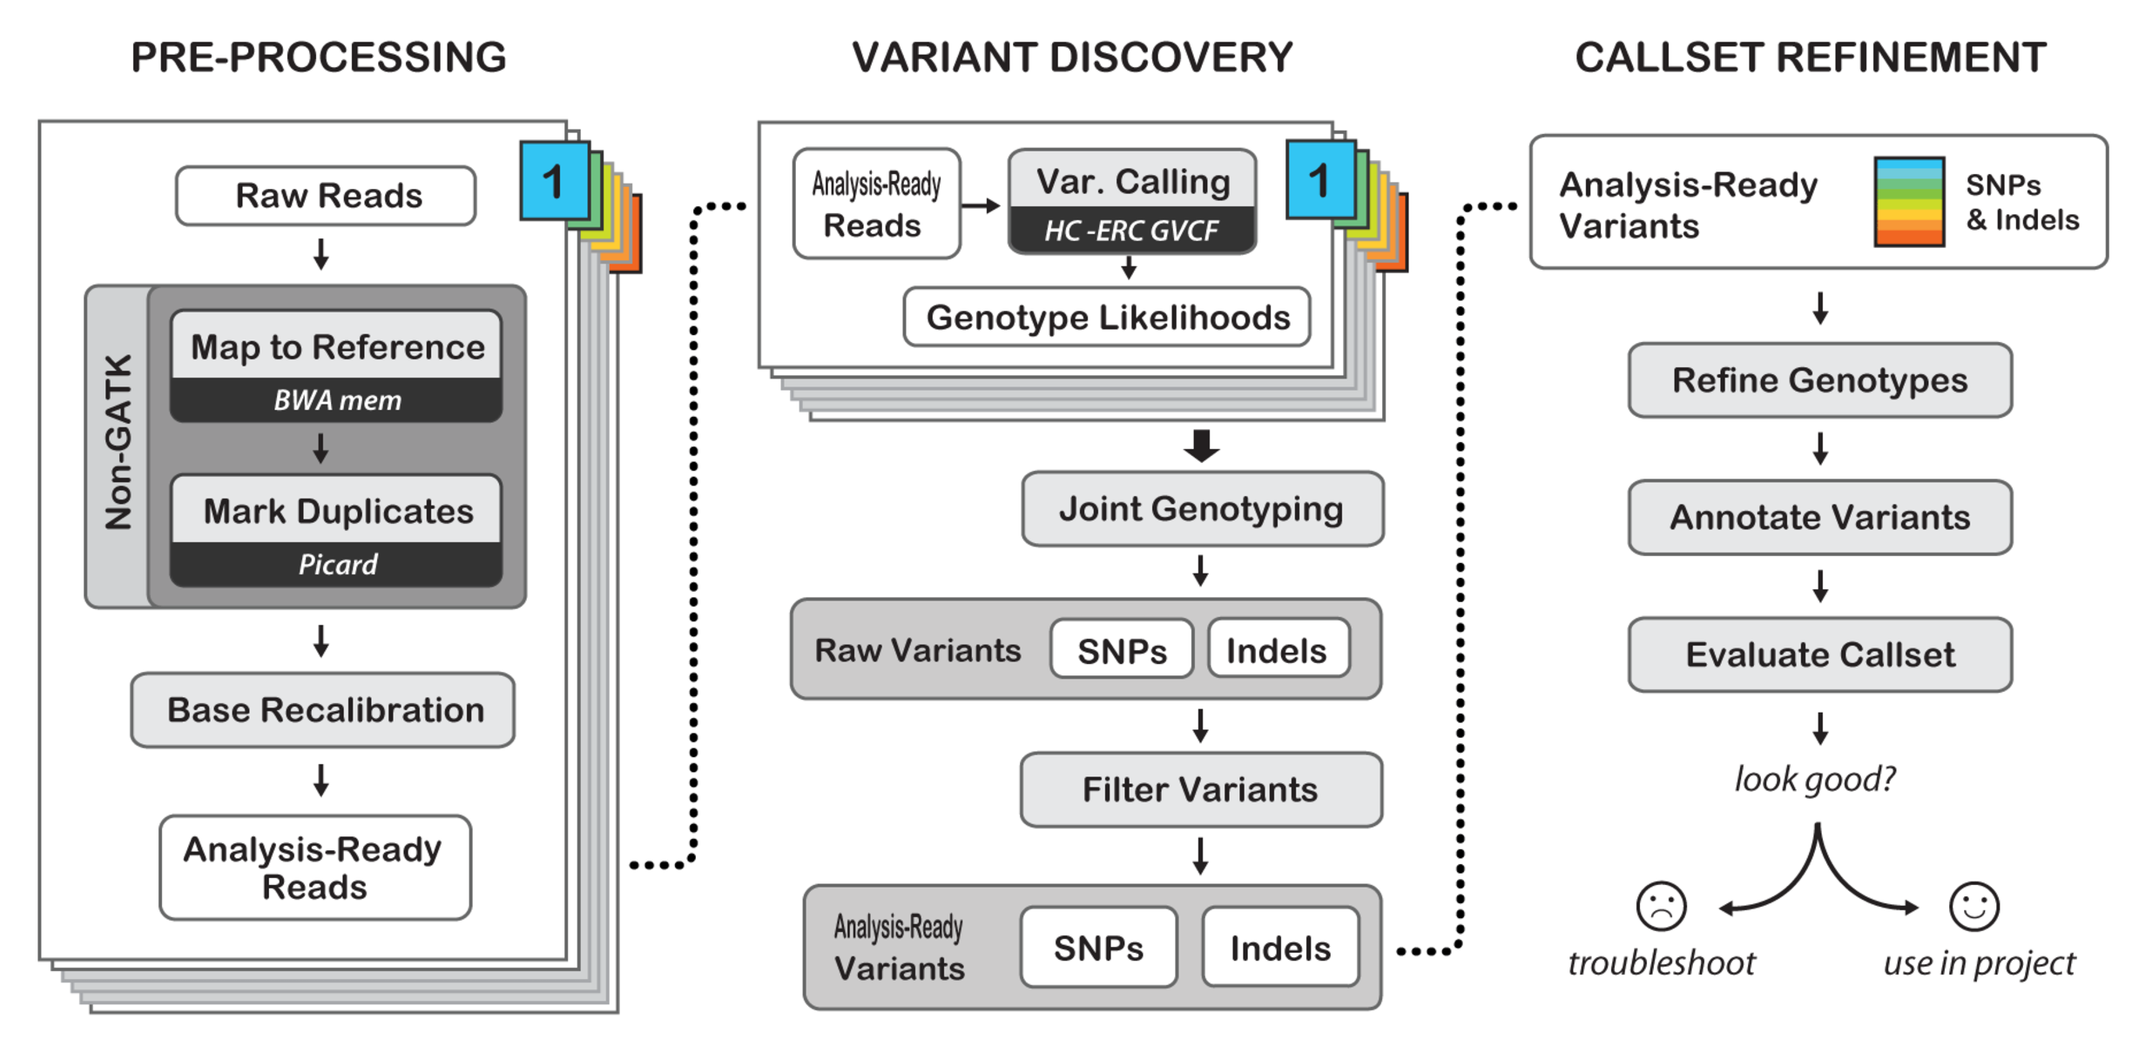
SNP CALLING
GATK Workflow

Slide 69
SNP CALLING
GATK: Strategies for Addressing Challenges
Specificity versus sensitivity: two-phases
Variant discovery using HaplotypeCaller – emphasizes sensitivity
Variant filtering – user controls specificity; can filter the same data set different ways
Variant filtering is supported by Variant Quality Score Recalibration (VQSR)

Slide 70
SNP CALLING
GATK: HaplotypeCaller
Calls SNPs and indels simultaneously via local de-novo assembly of haplotypes
Whenever the program encounters a region showing signs of variation, it discards the existing mapping information and reassembles the reads in that region
More accurate when calling regions that contain different types of variants close to each other
Can handle non-diploid organisms and pooled data, but not recommended for somatic calling

Slide 71
COMMAND LINE CONVENTIONS
# Comments preceded by hash
$ Command prompt starts with a dollar sign
VARIABLES_UPPERCASE_ITALICS
Single line command continued \
onto next line by a backslash

Slide 72
SNP CALLING
Exercise: Germline Variant Calling with HaplotypeCaller
# First we'll set up a shortcut to the data directory
$ export DATA=$HOME/dnaseq/data
# Next we'll check for errors in the BAM file
$ java –jar picard.jar picard.sam.ValidateSamFile \
INPUT=$DATA/bams/exp_design/NA12878_wgs_20.bam \
MODE=SUMMARY
# Now we'll call variants in a small region
$ java -jar GenomeAnalysisTK.jar -T HaplotypeCaller \
-R $DATA/ref/human_g1k_b37_20.fasta \
-I $DATA/bams/exp_design/NA12878_wgs_20.bam \
-o output/NA12878_wgs_20_HC_calls.vcf \
-L 20:10,000,000-10,200,000

Slide 73
SNP CALLING
Exercise: Germline Variant Calling with HaplotypeCaller
Load the variant calls into IGV: File > Open > {user}/output/NA12878_wgs_20_HC_calls.vcf
Browse to 20:10,000,000-10,002,000
Notice the new track at the top
Red indicates a homozygous SNP
Red/Blue indicates a heterozygous SNP
Zoom in to see how these called SNPs compare to the mismatches in the reads

Slide 74
SNP CALLING
Exercise: Germline Variant Calling with HaplotypeCaller
Scroll to the right (~10,002,460) and notice a variant with no apparent read support
Turn on "soft clipping" view: View > Preferences > Alignment > Show Soft-Clipped Bases
Notice all of the bases that the aligner could not align properly – HaplotypeCaller reassembled this region and discovered a variant that would have been missed by position-based callers

Slide 75
SNP CALLING
Results: Variant Call Format (VCF) Files
##fileformat=VCFv4.2
##FILTER=<ID=LowQual,Description="Low quality">
##FORMAT=<ID=AD,Number=R,Type=Integer,Description="Allelic depths for the ref and alt alleles in the order listed">
##FORMAT=<ID=DP,Number=1,Type=Integer,Description=”…">
...
##INFO=<ID=AC,Number=A,Type=Integer,Description="Allele count in genotypes, for each ALT allele, in the same order as listed">
##INFO=<ID=AF,Number=A,Type=Float,Description=”…">
…
FILTER: marker that the variant failed a condition
INFO: information given for each variant
FORMAT: information given in each genotype record

Slide 76
SNP CALLING
VCF Variant Rows
#CHROM POS ID REF ALT QUAL FILTER INFO FORMAT SAMPLE1 SAMPLE2...
chr1 51479 rs123 T A 3442.03 PASS AC=5;AF=0.404;AN=20 GT:AD:DP:GQ 0/0:14,0:14:42 0/0:2,0:2:6
ID: If variant is known, it’s database ID (e.g. dbSNP)
REF, ALT: the reference and alternate alleles
ALT may contain more than one allele, comma-separated
QUAL: PHRED-scale probability that there is no variant at this site

Slide 77
SNP CALLING
VCF Variant Rows
#CHROM POS ID REF ALT QUAL FILTER INFO FORMAT SAMPLE1 SAMPLE2...
chr1 51479 rs123 T A 3442.03 PASS AC=5;AF=0.404;AN=20 GT:AD:DP:GQ 0/0:14,0:14:42 0/1:2,2:4:6
For each sample:
GT: genotype call; 0 is reference, and 1, 2, … are alternate
0/0 is homozygous reference
0/1 is heterozygous
1/1 is homozygous alternate
‘.’ means no call
If there is a ‘|’ rather than ‘/’, the genotype is phased
GQ: PHRED-scale probability that the call is incorrect

Slide 78
SNP CALLING
GATK: Evaluating Variant Calls
We will use the VariantEval tool to determine
Numbers and types of variants
Concordance with reference dataset (dbSNP)
Ts/Tv ratio

Slide 79
SNP CALLING
Exercise: SNP Evaluation
$ java -jar GenomeAnalysisTK.jar \
-T VariantEval -R $DATA/ref/human_g1k_b37_20.fasta \
-eval output/NA12878_wgs_20_HC_calls.vcf \
-L 20:10,000,000-10,200,000 \
-D $DATA/vcfs/dbsnp_138.b37_20.vcf \
-noEV -EV CompOverlap -EV TiTvVariantEvaluator \
-EV CountVariants \
-o output/NA12878_wgs_20_Evaluation.eval.grp

Slide 80
SNP CALLING
Exercise: SNP Evaluation
TODO: results

Slide 81
SNP CALLING
GATK: Strategies for Addressing Challenges
Increasing specificity: Filtering
Two options: hard filtering and Variant Quality Score Recalibration (VQSR)
VQSR is best but does not work for small datasets
Hard filtering should only be attempted with coverage of at least 10x, and the higher the better

Slide 82
SNP CALLING
GATK: Hard Filtering
Filtering is based on specifying thresholds for one or more annotations (i.e. INFO fields)
One option is just to apply the default recommendations and hope for the best
The better (but more time-consuming) option is to understand your data by plotting it, then choose thresholds specific to your experiment

Slide 83
SNP CALLING
GATK: Variant Annotations for Filtering
Coverage (DP): Total (unfiltered) depth of coverage. Do not use with exome data!
QualByDepth (QD): Variant confidence (from the QUAL field) / unfiltered depth of non-reference samples.
Measure of strand bias (the variation being seen on only the forward or only the reverse strand)
For low-coverage data, use FisherStrand (FS)
Otherwise use StrandOddsRatio (SOR)
MappingQualityRankSumTest (MQRankSum): The rank sum test for mapping qualities.
ReadPosRankSumTest (ReadPosRankSum): The rank sum test for the distance from the end of the reads. If the alternate allele is only seen near the ends of reads, this is indicative of error.
RMSMappingQuality (MQ): Estimation of the overall mapping quality of reads supporting a variant call.
InbreedingCoeff: Evidence of inbreeding in a population. Only use >=10 samples.

Slide 84
SNP CALLING
Exercise: Hard Filtering – Defaults
# For low-coverage data, use "FS > 60" instead of SOR
$ java -jar GenomeAnalysisTK.jar \
-T VariantFiltration \
-R $DATA/ref/human_g1k_b37_20.fasta \
-V output/NA12878_wgs_20_HC_calls.vcf \
--filterExpression "QD < 2.0 || \
SOR > 3.0 || MQ < 40.0 || MQRankSum < -12.5 || \
ReadPosRankSum < -8.0" \
--filterName "HARD_FILTER" \
-o output/NA12878_wgs_20_HC_filtered_snps.vcf
# Look at the data and observe which SNPs have HARD_FILTER
$ less output/output/NA12878_wgs_20_HC_filtered_snps.vcf

Slide 85
SNP CALLING
Exercise: Hard Filtering – Understand the Data
# First we need to add some additional annotations to
# the variant INFO field
$ java -jar GenomeAnalysisTK.jar \
-R $DATA/ref/human_g1k_b37_20.fasta \
-T VariantAnnotator -A QualByDepth \
-A MappingQualityRankSumTest \
-I $DATA/bams/exp_design/NA12878_wgs_20.bam \
-V output/NA12878_wgs_20_HC_calls.vcf \
-o output/NA12878_wgs_20_annotated.vcf

Slide 86
SNP CALLING
Exercise: Hard Filtering – Understand the Data
# Now generate a table of metrics that we can plot
$ java -jar GenomeAnalysisTK.jar \
-R $DATA/ref/human_g1k_b37_20.fasta \
-T VariantsToTable -L 20:10000000-10200000 \
-V output/NA12878_wgs_20_annotated.vcf \
-F QD -F FS -F SOR -F MQ -F MQRankSum \
-F ReadPosRankSum \
-o output/NA12878_wgs_20_metrics.table

Slide 87
SNP CALLING
Exercise: Hard Filtering – Understand the Data
# The data in the metrics table can be plotted using
# R or Excel. Here's a simple R command to plot
# QualityByDepth (QD):
R > metrics = read.table(
'output/NA12878_wgs_20_metrics.table', sep="\t",
header=TRUE)
R > ggplot(metrics, aes(QD)) + geom_density()

Slide 88
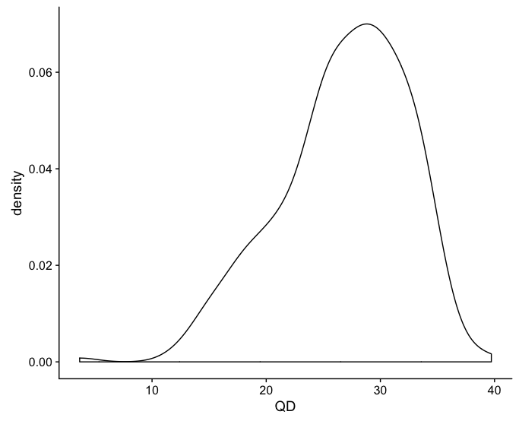
SNP CALLING
Exercise: Hard Filtering – Understand the Data

Slide 89
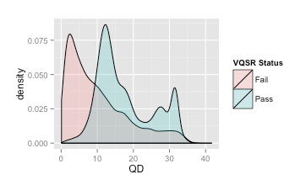
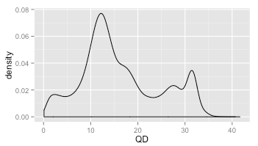
SNP CALLING
Dangers of Hard Filtering

Slide 90
SNP CALLING
GATK: VQSR
VQSR is a machine learning algorithm that uses reference variant calls to "learn" the criteria for judging the quality of your sample variant calls
Generates tranche plots that show the sensitivity/specificity tradeoff for different truth sensitivity thresholds
Filter variants using the threshold that best meets your needs

Slide 91
SNP CALLING
GATK: VQSR Workflow
Run VQSR to build the recalibration model and generate tranches
Examine tranche plots and decide on a threshold
Apply the threshold to filter your callset

Slide 92
SNP CALLING
GATK: VQSR Reference Callsets
Truth: all of the sites in the dataset are known to be true with some level of confidence
Training: the sites should be used to train the VQSR recalibration model
Known: the sites should be used to stratify output metrics
You assign each dataset a prior likelihood (phred scale) of truth

Slide 93
SNP CALLING
GATK: VQSR Reference Callsets
HapMap: Thoroughly validated callset (thruth=true, training=true, prior=Q15)
Omni: SNPs on the Illumina human Omni array (truth=true, training=true, prior=Q12)
1000G: Comprehensive callset with some false-positives (truth=false, training=true, prior=Q10)
dbSNP: Large database of known variants (truth=false, training=false, known=true, prior=Q2)

Slide 94
SNP CALLING
GATK: Tranche Threshold Values
VQSR
Assigns each variant a quality score (VQSLOD)
Ranks all variants by VQSLOD
Divides the dataset into tranches based on the threshold values you specify
Uses the reference callsets to determine the TP and FP rate within each tranche
Plots the tranches, which helps you to decide which threshold you want to use

Slide 95
SNP CALLING
GATK: VQSR Caveats
VQSR needs to be run separately for SNPs and indels
For exome experiments, at least 30 samples are recommended
Generally, the more samples the better. You can combine your samples with others for VQSR
VQSR needs a lot of data – we can't run it on just a small subset, and running on a whole genome takes too much time – so we will just understand the workflow and look at the outputs

Slide 96
SNP CALLING
GATK: Example VQSR Command
$ java -jar GenomeAnalysisTK.jar \
-T VariantRecalibrator \
-R reference.fa \
-input raw_variants.vcf \
-resource:hapmap,known=false,training=true,truth=true,prior=15.0 hapmap.vcf \
-resource:omni,known=false,training=true,truth=true,prior=12.0 omni.vcf \
-resource:1000G,known=false,training=true,truth=false,prior=10.0 1000G.vcf \
-resource:dbsnp,known=true,training=false,truth=false,prior=2.0 dbsnp.vcf \
-an DP -an QD -an FS -an SOR -an MQ -an MQRankSum -an ReadPosRankSum \
-an InbreedingCoeff \
-mode SNP \
-tranche 100.0 -tranche 99.9 -tranche 99.0 -tranche 90.0 \
-recalFile recalibrate_SNP.recal \
-tranchesFile recalibrate_SNP.tranches \
-rscriptFile recalibrate_SNP_plots.R

Slide 97
SNP CALLING
GATK: Tranche Plots

Slide 98
SNP CALLING
GATK: Example Apply Recalibration Threshold Command
$ java -jar GenomeAnalysisTK.jar \
-T ApplyRecalibration \
-R reference.fa \
-input raw_variants.vcf \
-mode SNP \
--ts_filter_level 99.0 \
-recalFile recalibrate_SNP.recal \
-tranchesFile recalibrate_SNP.tranches \
-o recalibrated_snps.vcf

Slide 99
SNP CALLING
GATK: Strategies for Addressing Challenges
Scalability: GVCF mode
HaplotypeCaller runs on each sample independently, generates intermediate output
All samples are genotyped jointly; genotyping is much faster than discovery
Pros
Variant calling can be done incrementally
Variant calling can be easily parallelized
Cons
GVCF files are quite a bit larger than regular VCFs

Slide 100
SNP CALLING
Exercise: Run HaplotypeCaller in GVCF Mode
$ java -jar GenomeAnalysisTK.jar -T HaplotypeCaller \
-R $DATA/ref/human_g1k_b37_20.fasta \
-I $DATA/bams/exp_design/NA12878_wgs_20.bam \
-o output/NA12878_wgs_20.g.vcf \
-ERC GVCF \
-L 20:10,000,000-10,200,000
# Look at results; how do they differ from regular VCF?
$ less output/NA12878_wgs_20.g.vcf
# Also look at the results in IGV

Slide 101
SNP CALLING
Exercise: Joint Genotyping
# Here we're only genotyping one sample; we'll see how
# to do multiple samples later
$ java -jar GenomeAnalysisTK.jar -T GenotypeGVCFs \
-R $DATA/ref/human_g1k_b37_20.fasta \
-V output/NA12878_wgs_20.g.vcf \
-o output/NA12878_wgs_20_jointcalls.vcf \
-L 20:10,000,000-10,200,000

Slide 102
Supplement

Slide 103
SEQUENCING TECHNOLOGY
Benefits of Long Read Technology
PacBio and Nanopore can generate reads of 10kb and longer (average is more in the 1-5 kb range)
PacBio increasingly used to:
Detect/resolve “difficult” regions
Assemble genomes of non-model organisms
Nanopore is compact, “real time” – increasingly used “in the field”
Can detect DNA modifications (e.g. methylation)
Soon will be possible to sequence RNA directly (i.e. without cDNA conversion)

Slide 104
SEQUENCING TECHNOLOGY
(Current) Drawbacks of Long-Read Technology
More expensive (but rapidly dropping)
Higher error rates; however:
These are also rapidly dropping
PacBio errors are random and thus correctable; software-corrected accuracy > 99%
Less tool support (but rapidly increasing)

Slide 105
ILLUMINA DNA LIBRARY PREPARATION
Synthetic Long Reads
Paired-end sequencing of long inserts
Used for:
Cheaper genome assembly
Genome phasing (i.e. resolving haplotypes)
Resolving large structural variants
Three options:
Manual: TruSeq long-read, Nextera mate-pair
Automated: 10X Chromium
Outsourced: Dovetail Genomics

